Slide 1

Note: The data and information in this document is reflective of a hypothetical situation and client. This document is to be used for KPMG Virtual Internship purposes only.
Sprocket Central Pty Ltd
Data analytics approach
[Division Name] - [Engagement Manager], [Senior Consultant], [Junior Consultant]

Slide 2
Note: The data and information in this document is reflective of a hypothetical situation and client. This document is to be used for KPMG Virtual Internship purposes only.
Agenda
Introduction
Data Exploration
Model Development
Interpretation

Slide 3
Note: The data and information in this document is reflective of a hypothetical situation and client. This document is to be used for KPMG Virtual Internship purposes only.
Introduction
Sprocket Central Pty Ltd, a medium size bikes & cycling accessories organisation which has a large dataset relating to its customers, but their team is unsure how to effectively analyse it to help optimise its marketing strategy.
The client provided us with 3 datasets:
Customer Demographic
Customer Addresses
Transactions data in the past 3 months

Slide 4
Note: The data and information in this document is reflective of a hypothetical situation and client. This document is to be used for KPMG Virtual Internship purposes only.
Data Exploration
Objective of the report
In the first Phase, i have conducted a data cleaning process on each dataset and joined them together.
Our objective is to answer the questions:
-What are the trends in the underlying data?
-Which customer segment has the highest customer value?
-Prior to performing any analysis we combined all the tables into one to make the analysis easier.
-We use specific Features that will help support our investigation.
-Some of the features’ datatypes were converted to certain datatypes to help with the analysis
-We draw some graphs to obtain insights on the data.For example the graph below shows that the age group 31-50 has the most orders

Slide 5
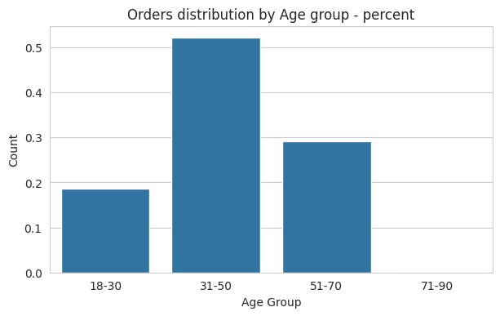

Slide 6
Note: The data and information in this document is reflective of a hypothetical situation and client. This document is to be used for KPMG Virtual Internship purposes only.
Model Development
-We compared the accuracy an performance of different models like,decisiontreeclassifier and random forest classifier.
-We used the decision tree model to predict new segments on the data.
-We then obtained the1000 new customers should be targeted to drive the most value for the organisation as shown below.

Slide 7
first_name | last_name | gender | RFM_segments_predicted
1 | Chickie | Brister | Male | Platinum
2 | Morly | Genery | Male | Bronze
3 | Ardelis | Forrester | Female | Silver
4 | Lucine | Stutt | Female | Gold
5 | Melinda | Hadlee | Female | Platinum
... | ... | ... | ... | ...
996 | Ferdinand | Romanetti | Male | Gold
997 | Burk | Wortley | Male | Gold
998 | Melloney | Temby | Female | Bronze
999 | Dickie | Cubbini | Male | Gold
1000 | Sylas | Duffill | Male | Gold

Slide 8
Note: The data and information in this document is reflective of a hypothetical situation and client. This document is to be used for KPMG Virtual Internship purposes only.
Interpretation
-As seen in the table above we have obtained the 1000 customers that the organization should focus on,as obtained through our model development.

